Slide 1
Are Graphs Hard in Rust?
@PayasR

Slide 2
Are Graphs Hard in Rust?

Slide 3
Are Graphs Hard in Rust?

Slide 4
Graphs
Graph data structure

Slide 5
Questions…!
What are graphs?
Graph representations:
How do we represent graphs in our programs?
Are all graph representations ‘hard’?
Which ones are hard only in Rust but not in other languages (C++)? Why?

Slide 6
A few questions to start with…
Graph Libraries:
How do we design reusable graph libraries?
Graph libraries = Graph representations + <Other components?> Are these other components hard too?
If Rust makes a few things harder, does it make anything easier?

Slide 7
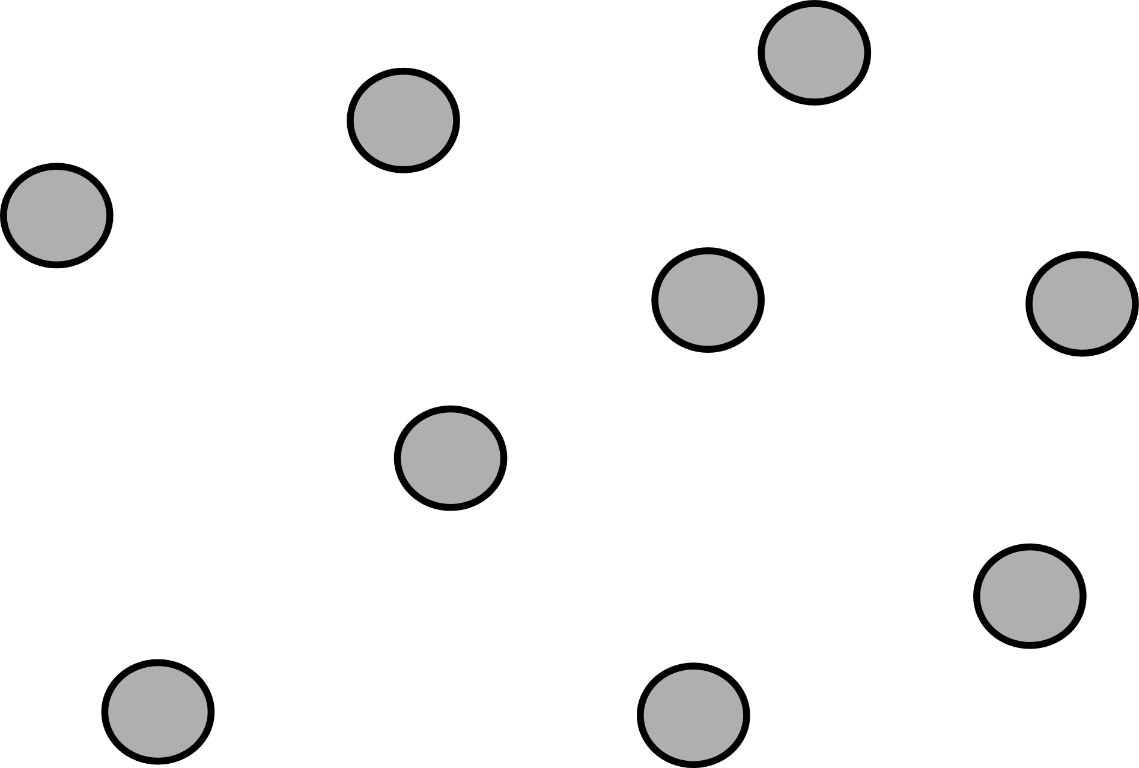
What are graphs?
A graph G consists of:
A set of vertices, V.
A set of edges, E, containing pairs (x, y) such that both x and y are in V.
Graph, G
Vertices, V
Vertices, V and Edges, E

Slide 8
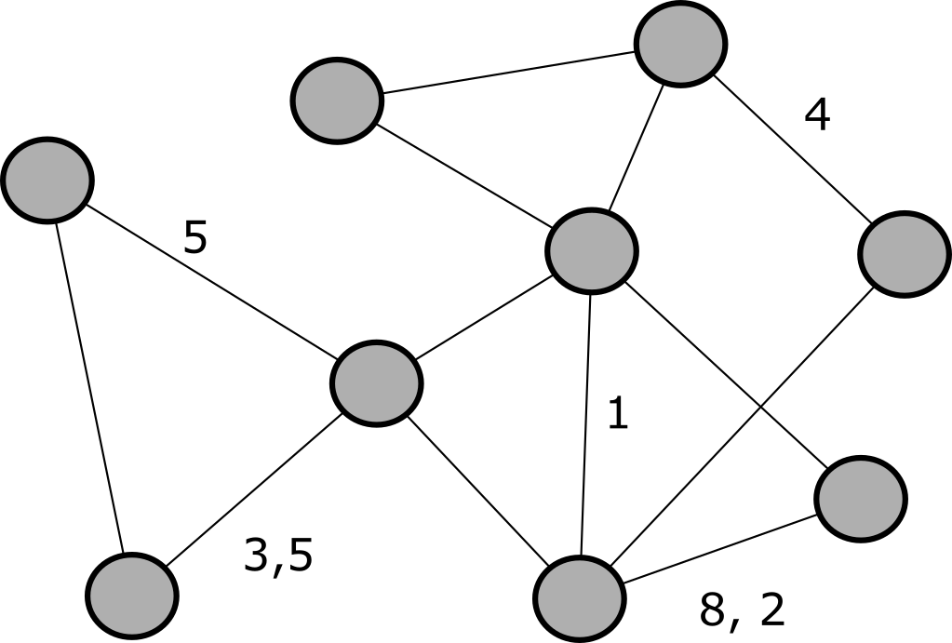
What are graphs?
A graph G consists of:
A set of vertices, V.
A set of edges, E, containing pairs (x, y) such that both x and y are in V.
Sometimes, some edges are associated with one or more edge weights.

Slide 9
Section 1: Graph Representations

Slide 10
Graph Representations: Adjacency Matrix
Represent graph as a V x V matrix.
An entry [m,n] in matrix is zero if there is no edge between vertices m and n.
An entry [m, n] in matrix is non-zero if there is an edge between vertices m and n.

Slide 11
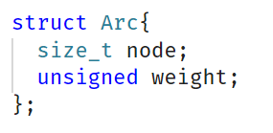
Graph Representations: Adjacency List
Array of V linked lists.
N^{th} linked list contains vertices adjacent to vertex N.
In practice, this often takes the form of a vector-of-vectors.

Slide 12
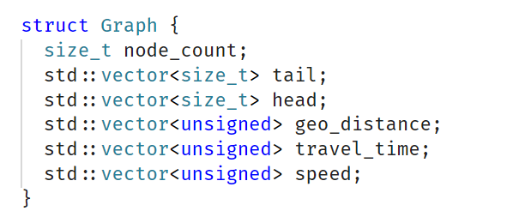
Graph Representations: Edge List (Arc List)
Literally, a list of all edges in the graph.
https://github.com/Project-OSRM/osrm-backend/wiki/Processing-Flow
https://github.com/RoutingKit/RoutingKit/blob/master/doc/SupportFunctions.md

Slide 13
Graph Representations: Adjacency Array
“A better representation than edge lists for graph traversal” - RoutingKit docs
Source:
https://github.com/RoutingKit/RoutingKit/blob/master/doc/SupportFunctions.md
https://www.sciencedirect.com/topics/computer-science/adjacency-list

Slide 14
Graph Representations: Doubly Connected Edge List (DCEL)
Used for planar embeddings of graphs.
Stores edges, vertices and faces of the graph.
Provides efficient manipulation of edges, vertices and faces.
Used in Computer Graphics.
Source:
https://www.sciencedirect.com/topics/computer-science/graph-representation

Slide 15
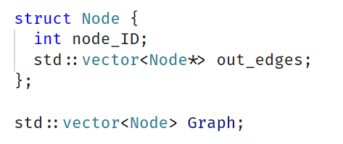
Graph Representations: Pointer-and-Struct
Each vertex is a struct.
Each vertex structure holds pointers to adjacent vertices in the graph.
Source:
https://www.sciencedirect.com/topics/computer-science/graph-representation

Slide 16
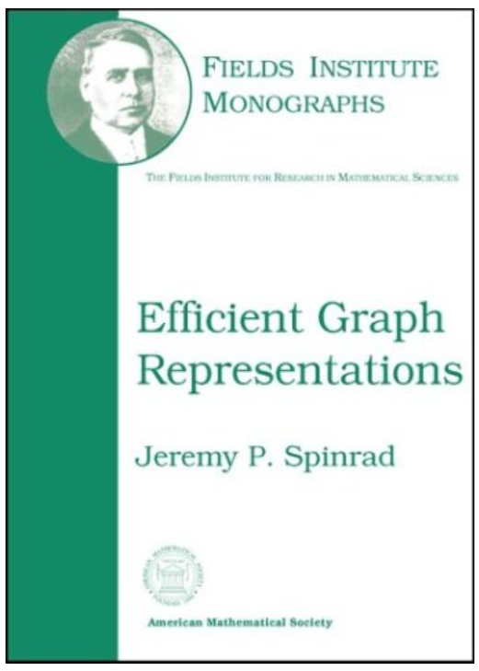
Graph Representations: The Book
Source:
https://bookstore.ams.org/fim-19

Slide 17
Questions?
We’ll talk about graph libraries next.

Slide 18
Section 2: Graph Libraries

Slide 19
The Design of Graph Libraries

Slide 20
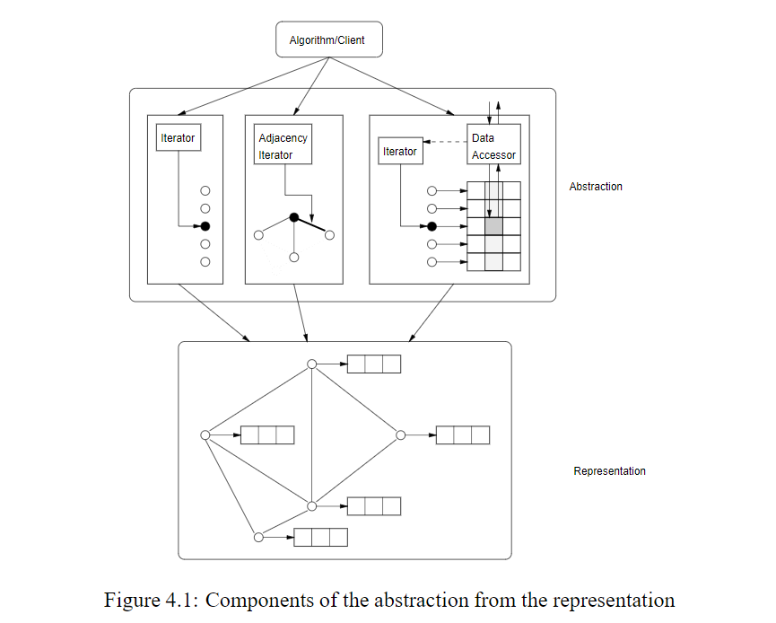

Slide 21
A Graph Library

Slide 22
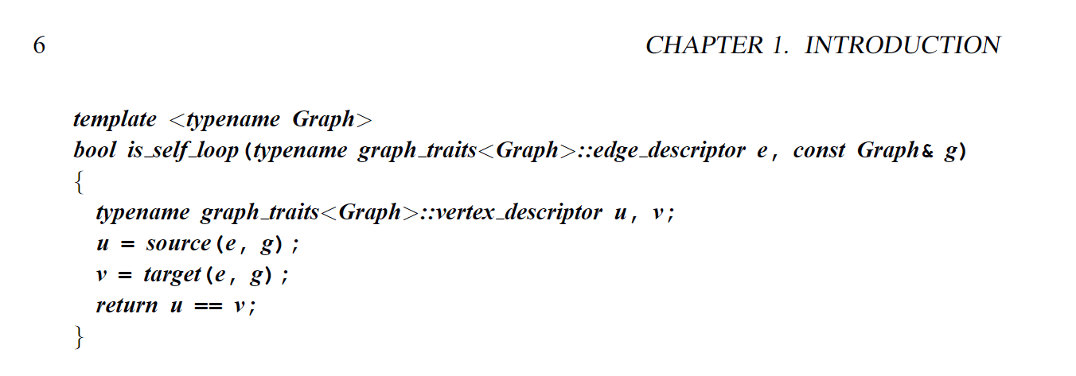
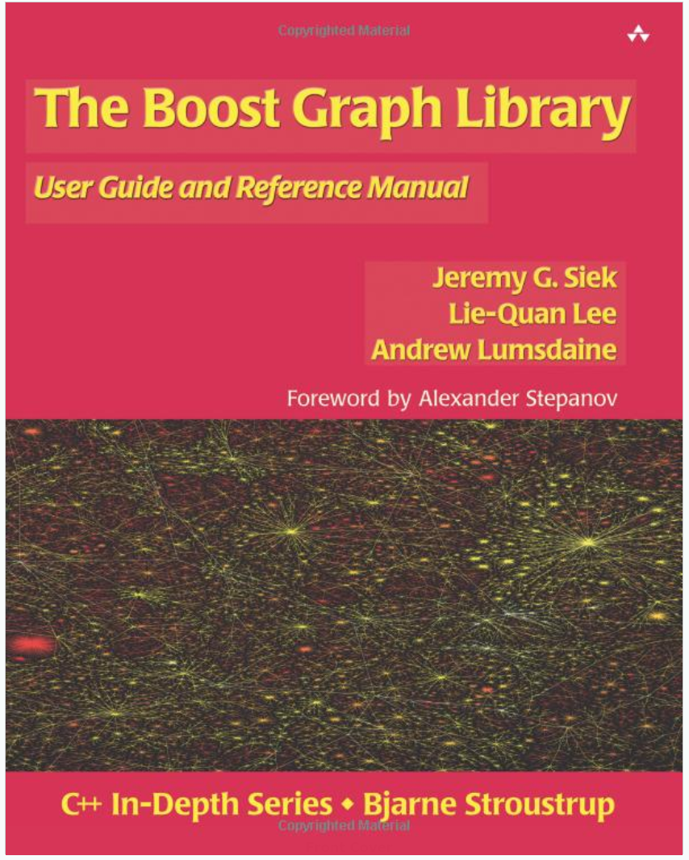
The Design of C++ Graph Libraries:
Boost Graph Library

Slide 23
The Design of C++ Graph Libraries: Boost Graph Library

Slide 24
The Design of C++ Graph Libraries: Boost Graph Library

Slide 25
The Design of C++ Graph Libraries: Boost Graph Library

Slide 26
The Design of C++ Graph Libraries: Boost Graph Library

Slide 27
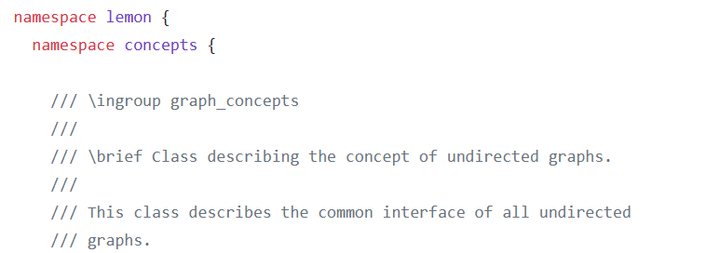
The Design of C++ Graph Libraries: LEMON
https://github.com/tpet/lemon/blob/master/lemon/concept_check.h

Slide 28
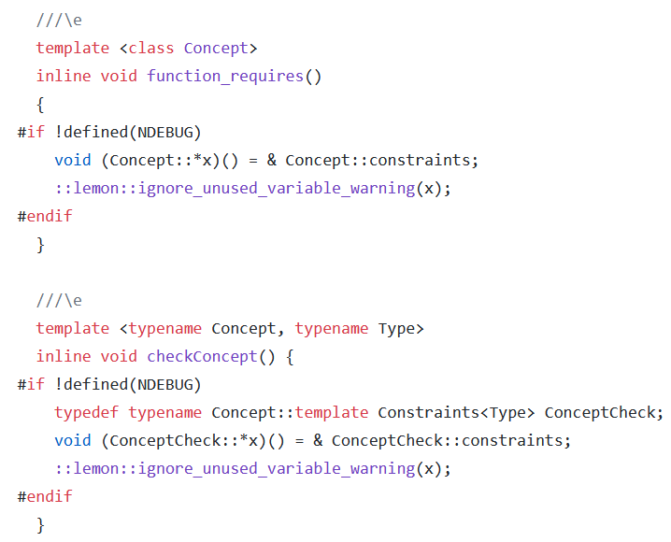
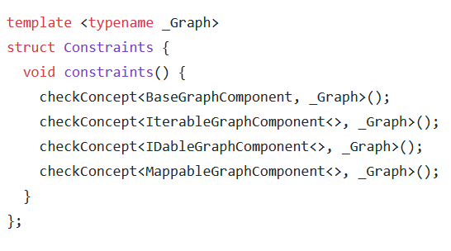
The Design of C++ Graph Libraries: LEMON
https://github.com/tpet/lemon/blob/master/lemon/concept_check.h

Slide 29
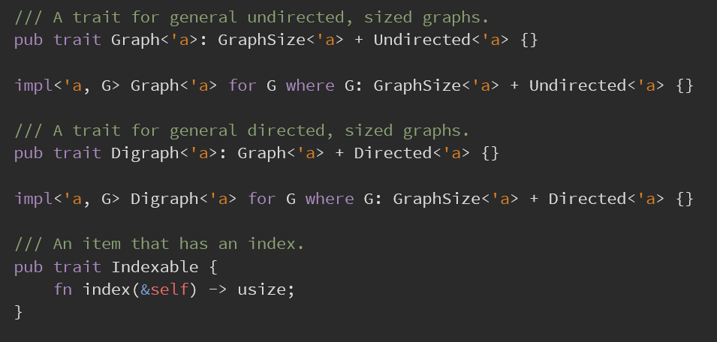
The Design of Rust Graph Libraries: (rs_graph)
Traits are first class citizens in Rust!!
https://docs.rs/rs-graph/0.19.2/src/rs_graph/linkedlistgraph.rs.html

Slide 30
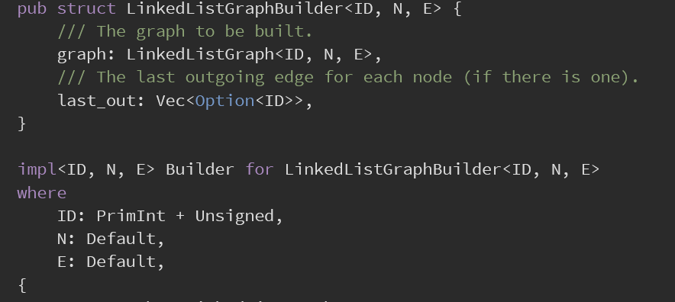
The Design of Rust Graph Libraries: (rs_graph)
Implementing graph traits to get concrete graph types:

Slide 31
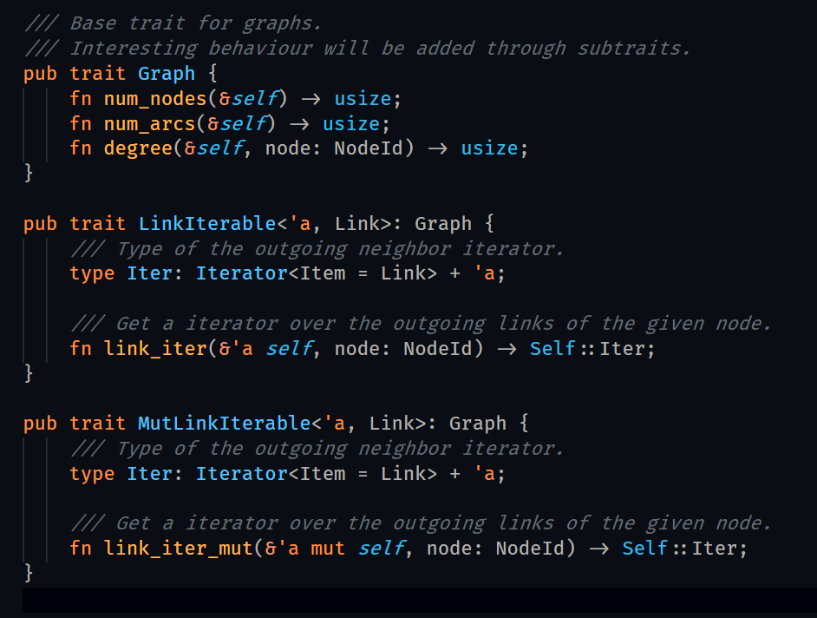
The Design of Rust Graph Libraries: (rust_road_router)
Graph Traits:

Slide 32
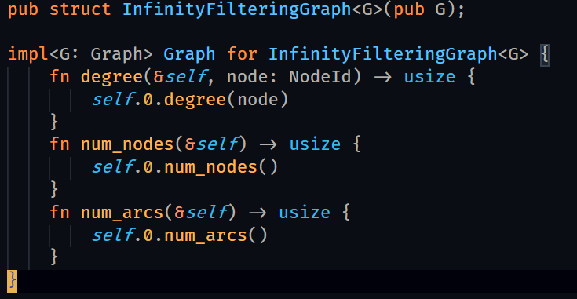
The Design of Rust Graph Libraries: (rust_road_router)
Graph Implementation:

Slide 33
Comparing the C++ and Rust Libraries: Graph Interfaces
Traits being first class citizens in Rust saves us from metaprogramming tricks and Boost MPL!
So, are generic graph interfaces hard in Rust? No.

Slide 34
Comparing the C++ and Rust Libraries: Graph Representations – Adj. Matrix
C++
Rust

Slide 35
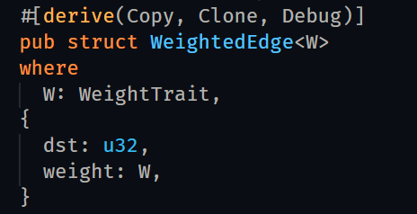
Comparing the C++ and Rust Libraries: Graph Representations – Adj. List
C++
Rust

Slide 36
Comparing the C++ and Rust Libraries: Graph Representations – Pointer & Struct
C++
Rust
???
Do you need it?
Do you really need it?
Use ‘unsafe’ and write tests.

Slide 37
Conclusion (?)
So, are generic graph interfaces hard in Rust? No.
So, are some graph representations hard in Rust? No, but pointer & struct graphs need ‘unsafe’ and tests.
But you shouldn’t be using pointer & struct graphs anyway.
For representations that you _should_ use, Rust code looks a lot like C++ code.

Slide 38
Are Graphs Hard in Rust?

Slide 39
Are Graphs Hard in Rust?

Slide 40
Thank you!
Tim Zeitz
Dev Purandare
Daniel Bittman
Peter Wilcox
Lawrence Lawson
Soham

Slide 42
Thank you for your time.
@PayasR
(Twitter, GitHub, LinkedIn)

Slide 43
Bonus Slide: What about C++ Concepts?

